Slide 1


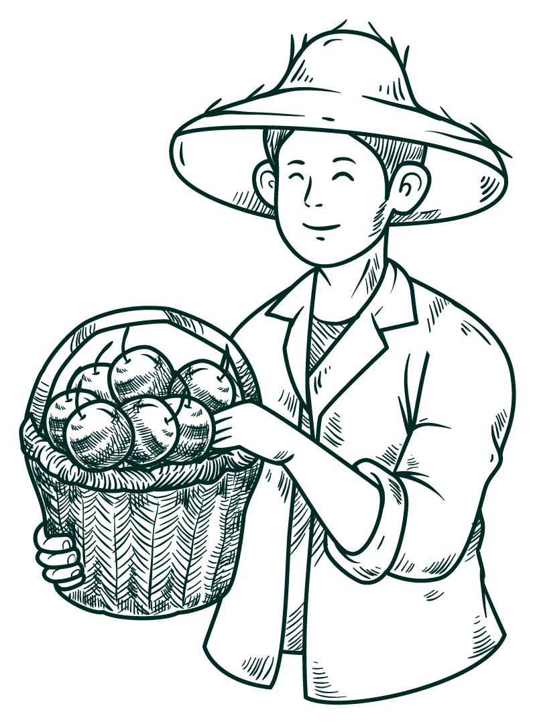



FARMER sUPPORT aPPLICATION
A WEB TECHNOLOGY PROJECT UNDER THE GUIDANCE OF VEDA SHRI MAM

Slide 2


Table of contents
01
02
03
04
Tech stack
INTRODUCTION
ROAD MAP
FEATURES
05
demonstration

Slide 3
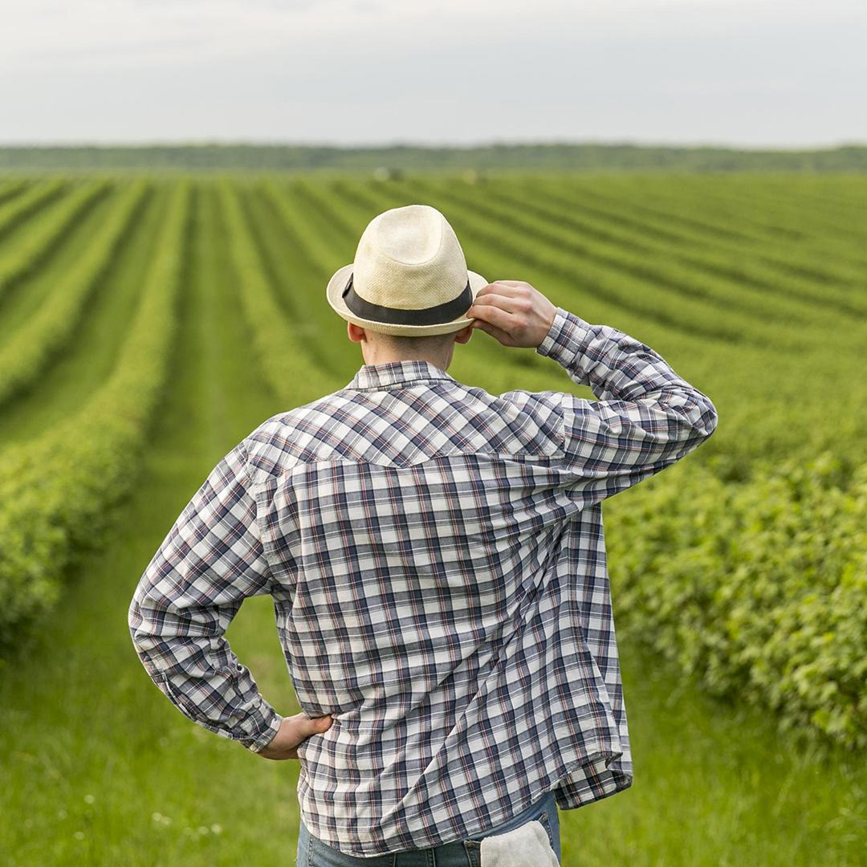

Why this application
As per the data from Census 2011, there are 118.9 million cultivators in India, which constitutes about 24.6% of the total workforce of over 481 million:
We want to organise them for a better lifestyle.
This application is an end-to-end farmer support destination.
"किसान है, तो हम हैं।"

Slide 4

Introduction
Purpose of the application: to provide comprehensive support to farmers.
Key features: access to agricultural information, market linkage, financial services, community engagement, and decision support tools.
Potential impact and benefits: increased productivity, income generation, food security, and rural development.
Our application can provide a feature to book soil checkups, give precise weather forecasting and have AI assistance to help farmers at every step.

Slide 5








Tech Stack

Slide 6

Process of work
idea
structure
Agricultural hub and farm solution.
We decided what things to add.
layout
execution
Created the basic layout where we started to give a real layout.
Putting ideas into the right path with the help of front-end and back-end technology we came to an end.

Slide 7
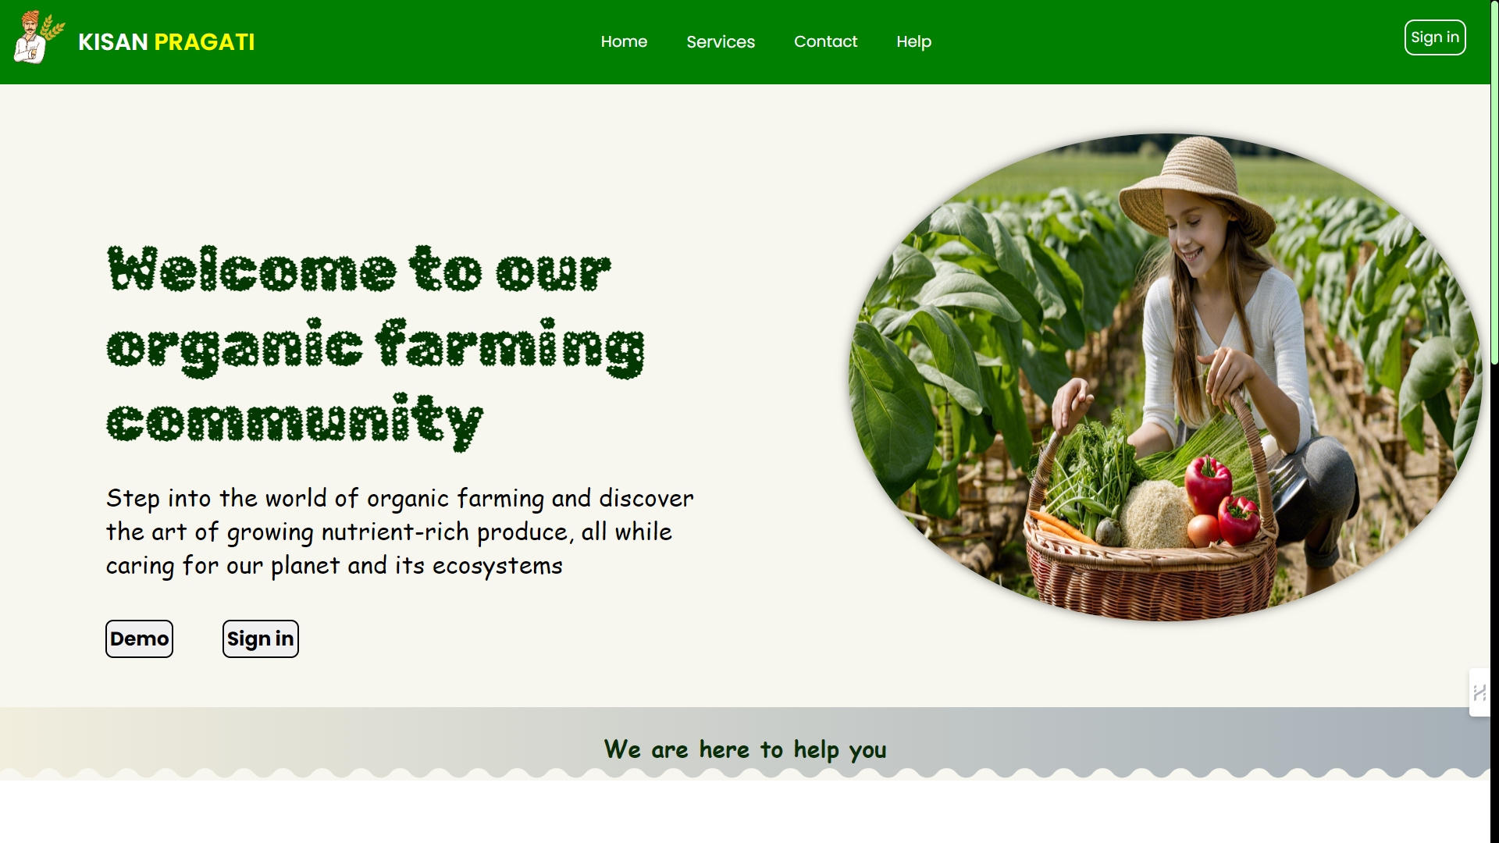

features
Help in modern farming techniques.
Plant health detection.
Weather precision and process get the best yield.
Help in the growth of organic farming.
Livestock selling and buying platform.

Slide 8
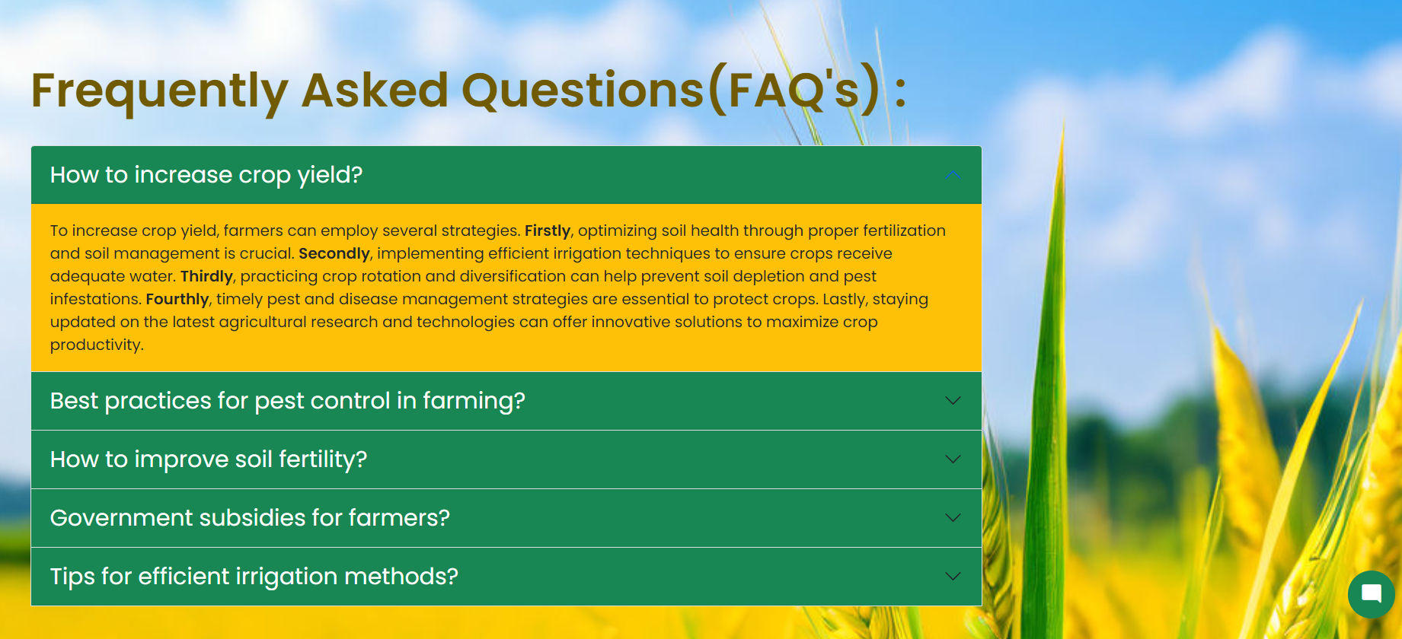
features
FAQ’s section for farming queries.
Al chat assistance for one-to-one help.
Soil checkup for better yield and nutrients.
Financial support to farmers.
Technology meets the wonders of creating magic.

Slide 9
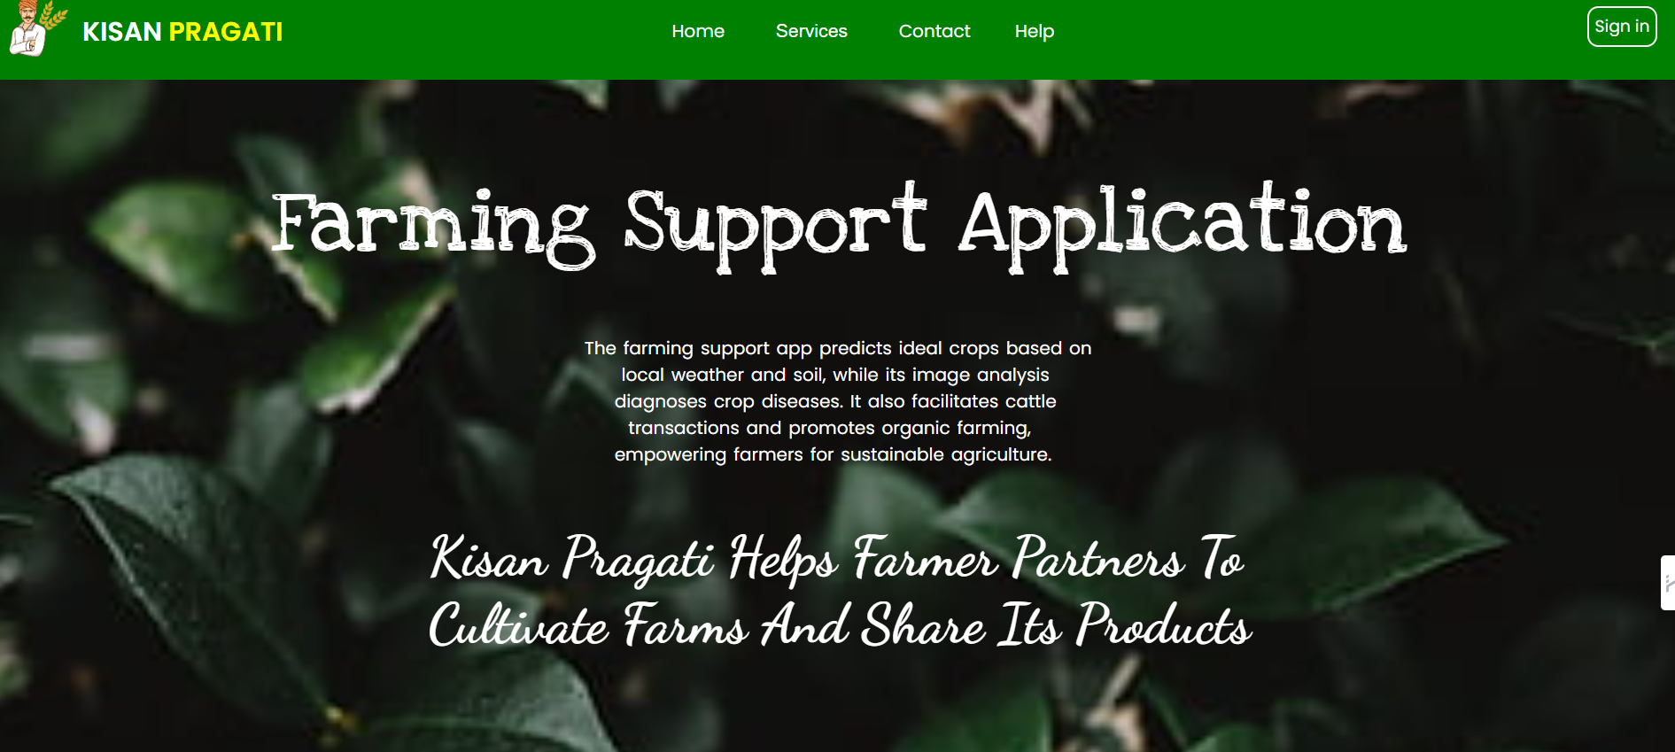
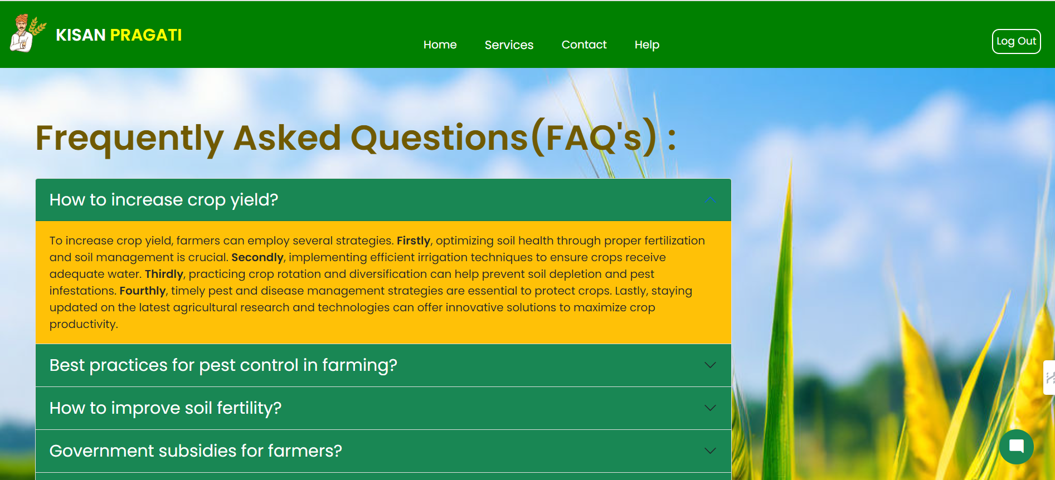

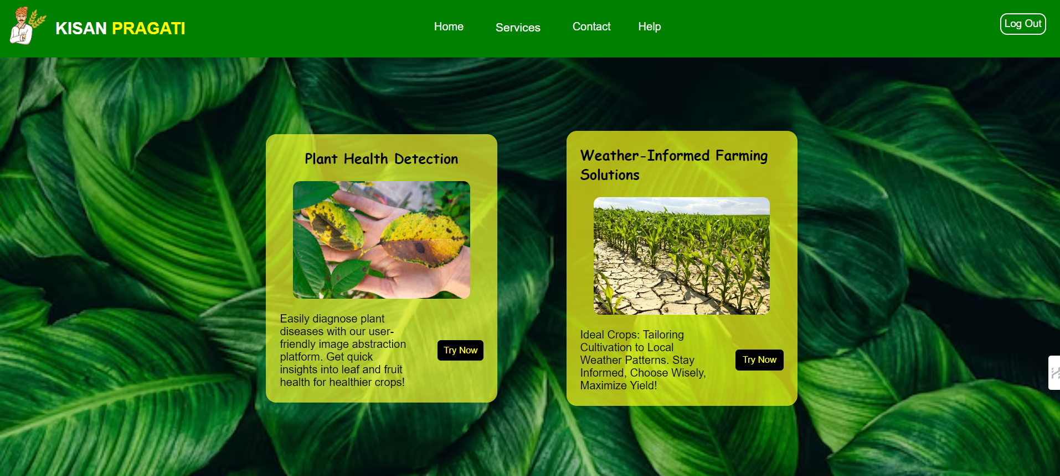
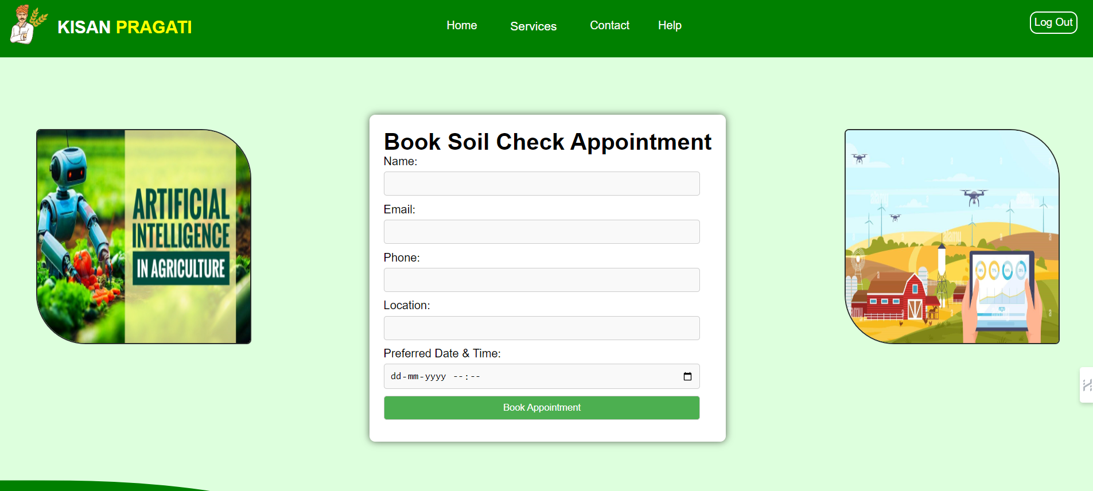
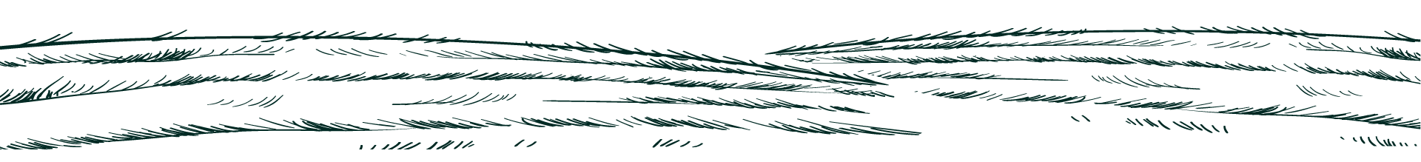
demonstration

Slide 10
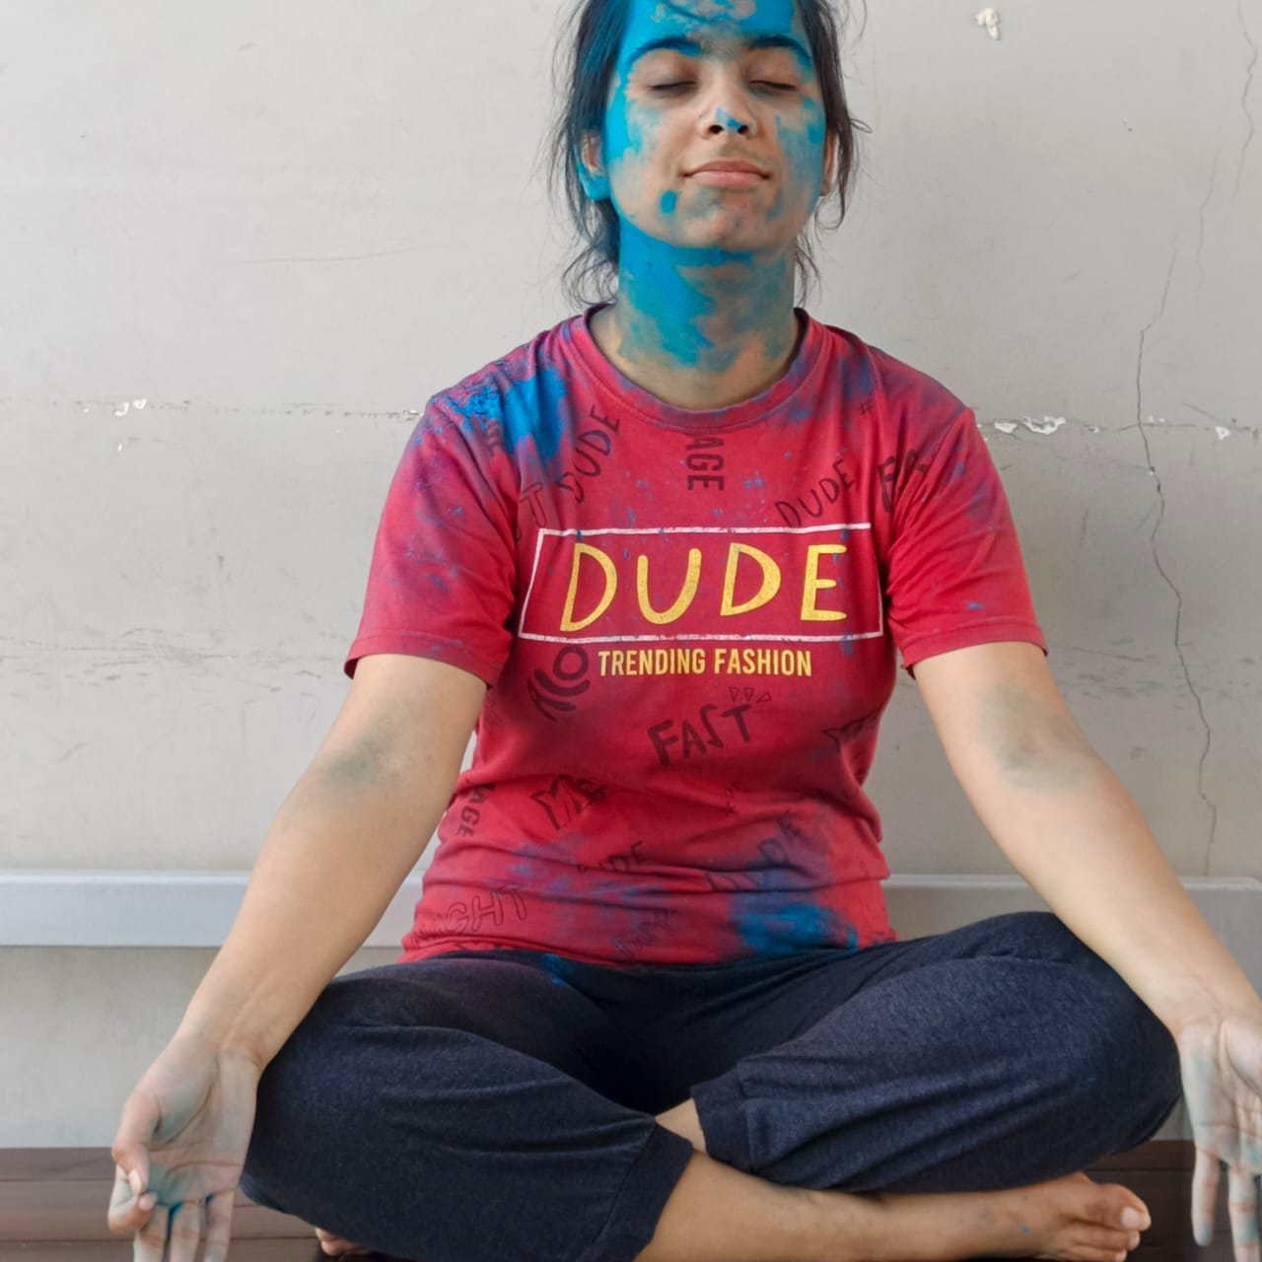
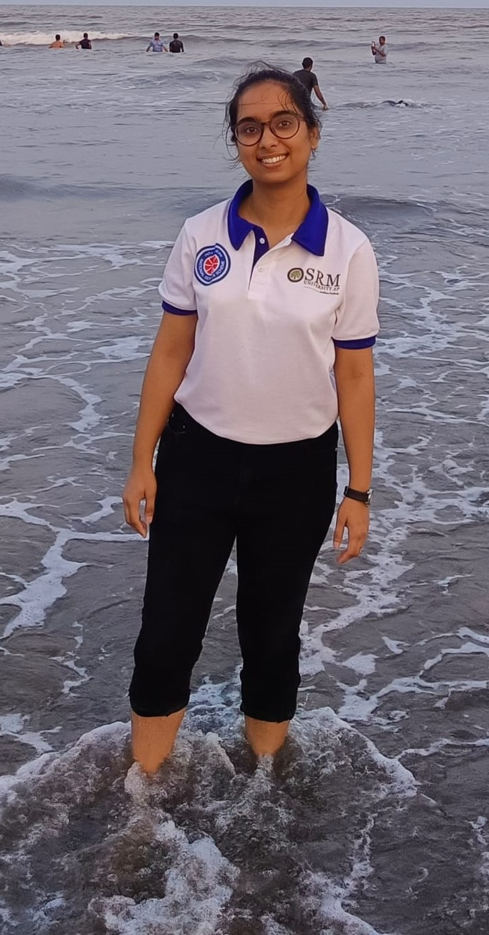
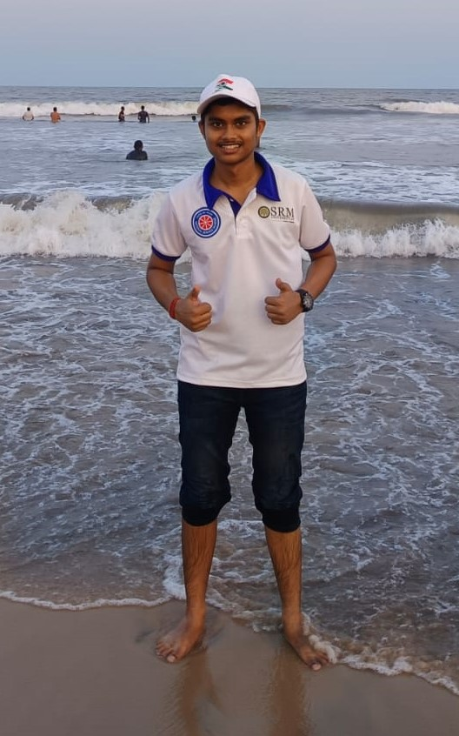
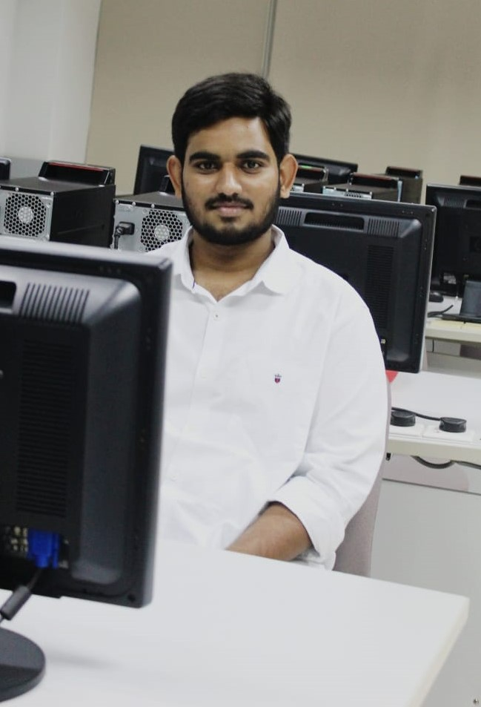
Thanks!
You all are a beautiful audience thank you for giving us time.
Signing Off

